Slide 1
GUESSING GAME: MASTERMIND
Ahmad Zaidan bin Adnan 1718733
Muhammad Salikin bin Ismail 1711083
Mohamad Zaki bin Jaafar 1719207
Mohd Syafiq Asyraf bin Samsudin 1715447

Slide 2
INTRODUCTION
Guessing Game : Mastermind is a program designed to represent the Mastermind board game.
The game is usually played by two players.
However, this program lets the user to play against the computer.

Slide 3
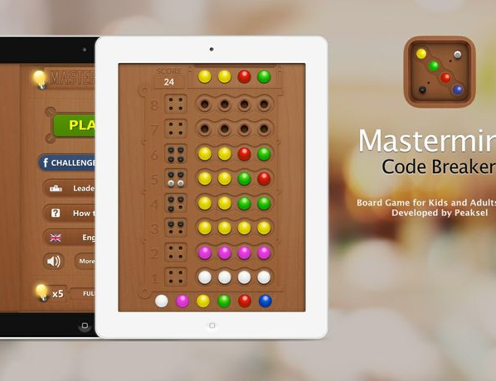
Mastermind
Guessing Game

Slide 4
FUNCTIONS
main()
The function that will call the main functions in the program and close the program.
loading()
The function shows the interactive loading bar in the program.
menu()
The function shows the main menu of the program.

Slide 5
FUNCTIONS CONTD’
start()
The function execute the process of the guessing game.
instruct()
The function shows the instructions of the game.
score()
The function retrieves data from another file to represent the high scores of players.

Slide 6
FUNCTIONS CONTD’
exit()
The function returns a value into main function in order to exit from the while loop and exit the program subsequently.
welcome()
The function executes a large sign of the program’s name.
Choose()
The function that lets you choose the options on the main menu.

